Slide 1
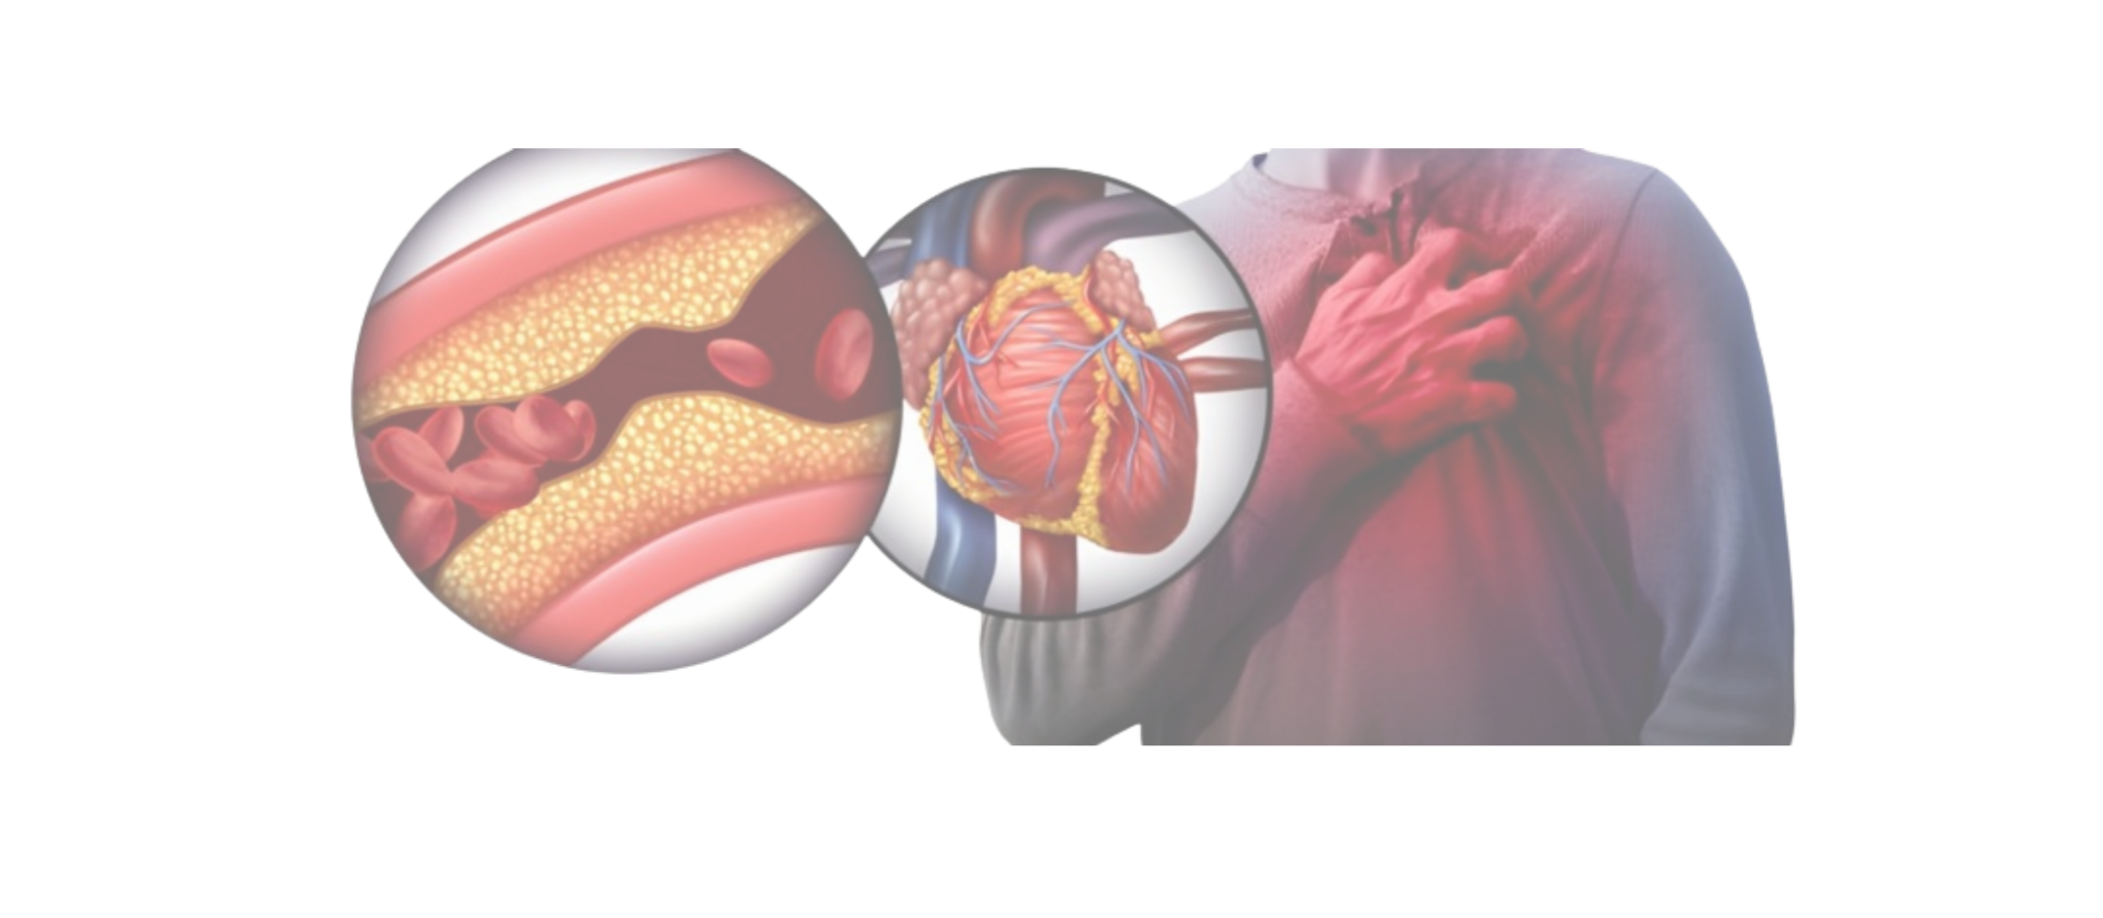
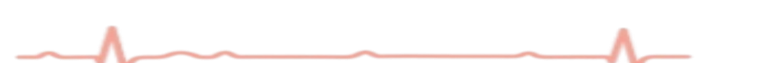
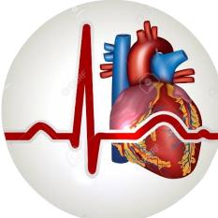
Heart Block 1st, 2nD, 3rd Degree BLOCK,
RBBB, LBBB
& Other Heart Blocks
Miss Temitope haastrup

Slide 2

Outline
Conducting system
Definition and Cause
First Degree Heart Block
Second Degree Heart Block
Mobitz Type I
Mobitz Type II
Third Degree Heart Block
Bundle Branch Block
Others

Slide 3
Conductive System
Conductive System It is formed by the modified Cardiac muscle fibers.
These fibers are concerned with propagation of impulse along the conduction pathway
Functional anatomy of the conduction Pathway
Sino-atrial node (SAN)
Atrioventricular node (AVN)
Bundle Of His
Right and left bundle branches
Purkinje fibers.

Slide 4
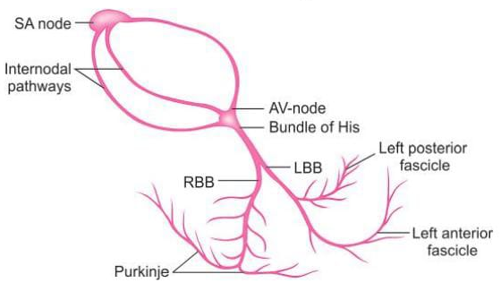

Slide 5
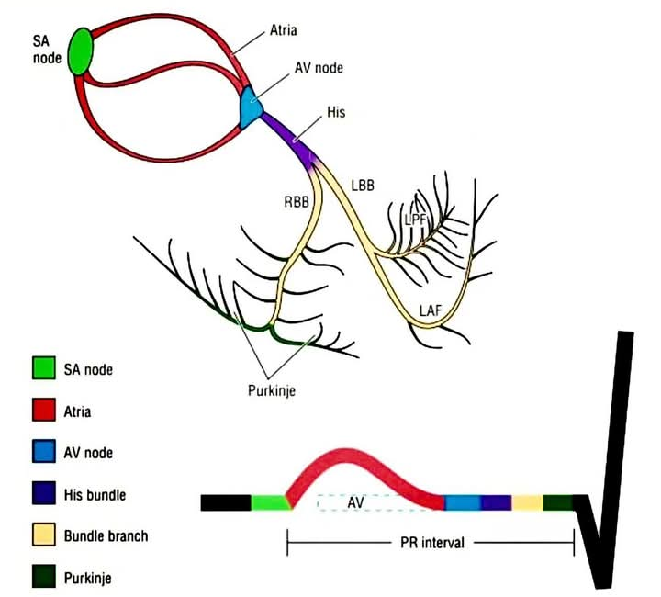

Slide 6
Definition & Cause
Heart block or Interference with Conduction: It occur as a delays or faults in relay or propagation of impulse
Causes
Congenital heart disease
Inferior myocardial infarction
Cardiomyopathy
Degenerative disease
Amyloidosis
Tumor

Slide 7
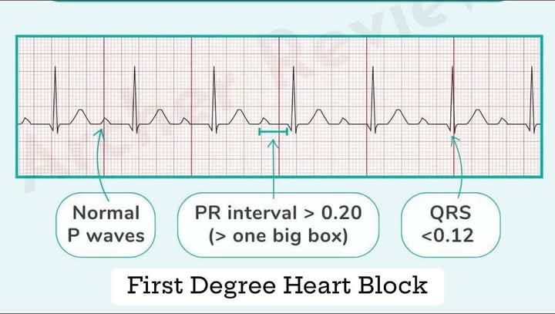
Types of Heart Block
First Degree Heat black
It involve mere delay beyond a Stipulated time
Features
-Prolong PR interval > 0.20s
-Normal P wave
-Normal QRS Complex

Slide 8
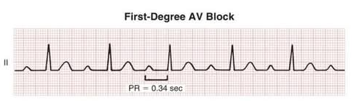
Types of Heart Block
PR – 0.36S
PR – 0.40S
PR – 0.44S

Slide 9
Second Degree Heart Block
Second degree Heart Block: Delay is of higher severity such that occasioned or Intermittent supraventricular impulse fail to reach the Ventricle
Types
2nd Degree (Mobitz Type 1 aka Wenckebach)
Features
Progressive Prolongation of cumulating in non conducted P wave
PR longest before dropped beat.
PR shortened after dropped beat
Narrow & irregular rhythm

Slide 10
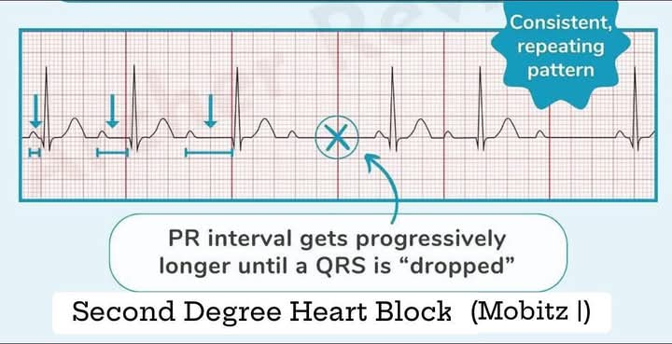
Second Degree Heart Block

Slide 11
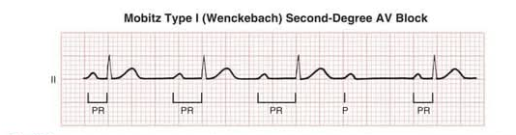
Con’t

Slide 12
Con’t
2nd Degree (Mobitz Type II)
PR interval is fixed but there is a sudden drop Of QRS Complex (missed beat)
Feature
Non-Conducted P wave without 'warning' of PR Prolongation
PR intervals in conducted beat is Constant
QRS often wide

Slide 13
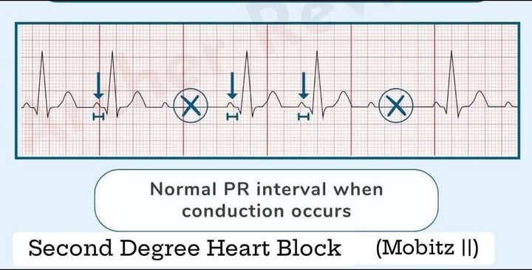

Slide 14
THIRD DEGREE HEART BLOCK
3rd Degree Heart Block or Complete Heart Block
This is complete heart block
No relationship between the P wave and QRS Complex
Several missed beat may Consecutively occur causing “pauses”

Slide 15
Bundle Branch Block
Bundle Branch Block
Interruption of the propagation of electrics impulse at the level of bundle branch
Types
Right Bundle Brach Block (RBBB)
Left Bundle Branch Block (LBBB)

Slide 16
RIGHT Bundle Branch Block
ECG FEATURES
Broad QRS Complex
RSR Complexes (M-Pattern) in V1- V3
ST-Segment depression V1 – V2
T wave inversion in V1-V2
Deep S wave in left, lateral leads I, aVL, V5, V6

Slide 17
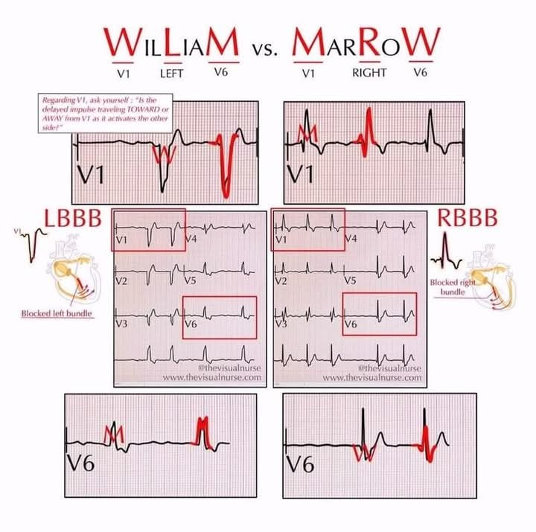
Heart Block

Slide 18
CON’T
Causes
Normal Variant in some people
Acquired Myocardia Disease
-Myocardia infarction
-Cardiomyopathy
-Degeneration diseases of conducting system
Congenital Heart Disease
-Tetralogy of Fallot (TOF)
-Atrial Septal defect (ASD)
-Ventricular Septal Defect (VSD)
Pulmonary disease
Pulmonary Embolism

Slide 19
LEFT BUNDLE BRANCH BLOCK
ECG FEATURES
Board QRS Complex
Slurred or notched broad R waves in left lateral leads (I,aVL,V5 V6
ST segment depression, T-wave inversion in V5 V6
Deep S wave in V1 V2

Slide 21
LBBB
Causes
Hypertension
Aortic stenosis
Myocardia Infarction etc.

Slide 22
Hemiblock (fascicular Block)
Left Anterior fascicular Block
(ECG feature)
Left axis deviation
Prominent R wave in lead I & III
Prominent S wave in lead I & III
QRS complex, ST Segment and T wave are normal

Slide 23
CON’T
Left posterior fascicular block
(ECG Feature)
Right Axis Deviation
Prominent S waves in lead I and R wave in Lead II
QRS Complex, ST-segment and T wave are normal

Slide 24
BifasciculAr Block
Bifascicular Block: This involves two fascicle
Example
RBBB + Left Posterior fascicular block
( ECG feature)
RSR! V1& V₂
Deep S waves in Lead 1, aVL, V5, V6
-Broad QRS Complex
-Significant RAD (right axis deviation)

Slide 25
BifasciculAr Block
LBBB + Left Anterior fasciculus
(ECG Feature)
Significant Left Axis Deviation
-RSR! Complex in V1, V2
-Deep S wave in lead I, aVL,V5, V6,
-Broad QRS Complex

Slide 26
Tri fascicular Block.
Tri fascicular Block.
A) RBBB + Heart Block + hemi block
B) LBBB + Heart block + hemi block

Slide 27
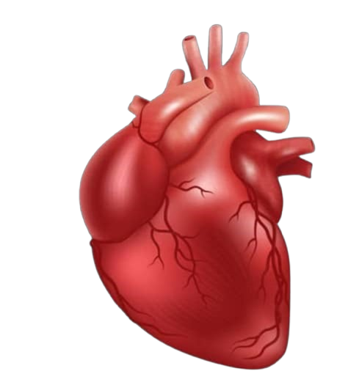
THANK YOU

